Slide 1


DESIGN 1
Lesson 1: Ordered vs. Unordered Lists
Ms. Abboud • Grade 9 - Design 1 • Term 1, Week 4

Slide 2
Learning Objectives
WALT - We Are Learning To
WILF - What I'm Looking For
Explain the difference between ordered and unordered lists.
Identify when to use each list type on a real page.
Can explain the difference between <ul> and <ol>.
Can give a correct real-world example of each.

Slide 3
Academic Vocabulary
Ordered List
Unordered List
A numbered list (<ol>), used when the sequence of items matters (e.g. steps in a process).
A bulleted list (<ul>), used when the order of items doesn't matter (e.g. a list of hobbies).
List Item
The <li> tag - each individual entry inside an ordered or unordered list.

Slide 4
Frayer Model: Ordered List
DEFINITION
CHARACTERISTICS
A numbered list (<ol>), used when the sequence of items matters.
Numbered automatically; items must stay in a specific order; changing the order changes the meaning.
ORDERED LIST
EXAMPLES
NON-EXAMPLES
<ol>
<li>Step 1</li>
<li>Step 2</li>
</ol>
A list of favorite colors - order doesn't matter, so <ul> fits better.

Slide 5
National Identity Integration
UAE Heritage and Culture: ordered lists can present Emirati traditions or historical events in the sequence they happened - helping readers follow a story or process, like the steps of a traditional ritual.

Slide 6
STARTER
Recipe vs. Shopping List
Look at a recipe's numbered steps and a shopping list, side by side.
What's different about how these two are organized?
Hook • Engage & Ask
5 - 10 minutes

Slide 7
LESSON CORE
I Do: Teacher Demo
<ul> = unordered/bulleted (order doesn't matter); <ol> = ordered/numbered (sequence matters).
Gradual Release of Responsibility
Example: one of each list type
30 - 40 minutes
<h2>My Hobbies</h2>
<ul>
<li>Reading</li>
<li>Coding</li>
</ul>
<h2>My Steps</h2>
<ol>
<li>Plan</li>
<li>Build</li>
</ol>
1 / 3

Slide 8
LESSON CORE
We Do: When Would a Website Use Each?
Nav menu = unordered (the order of links doesn't usually matter).
Step-by-step instructions = ordered (sequence matters).
Guided notes: record both syntaxes side by side.
Gradual Release of Responsibility
30 - 40 minutes
2 / 3

Slide 9
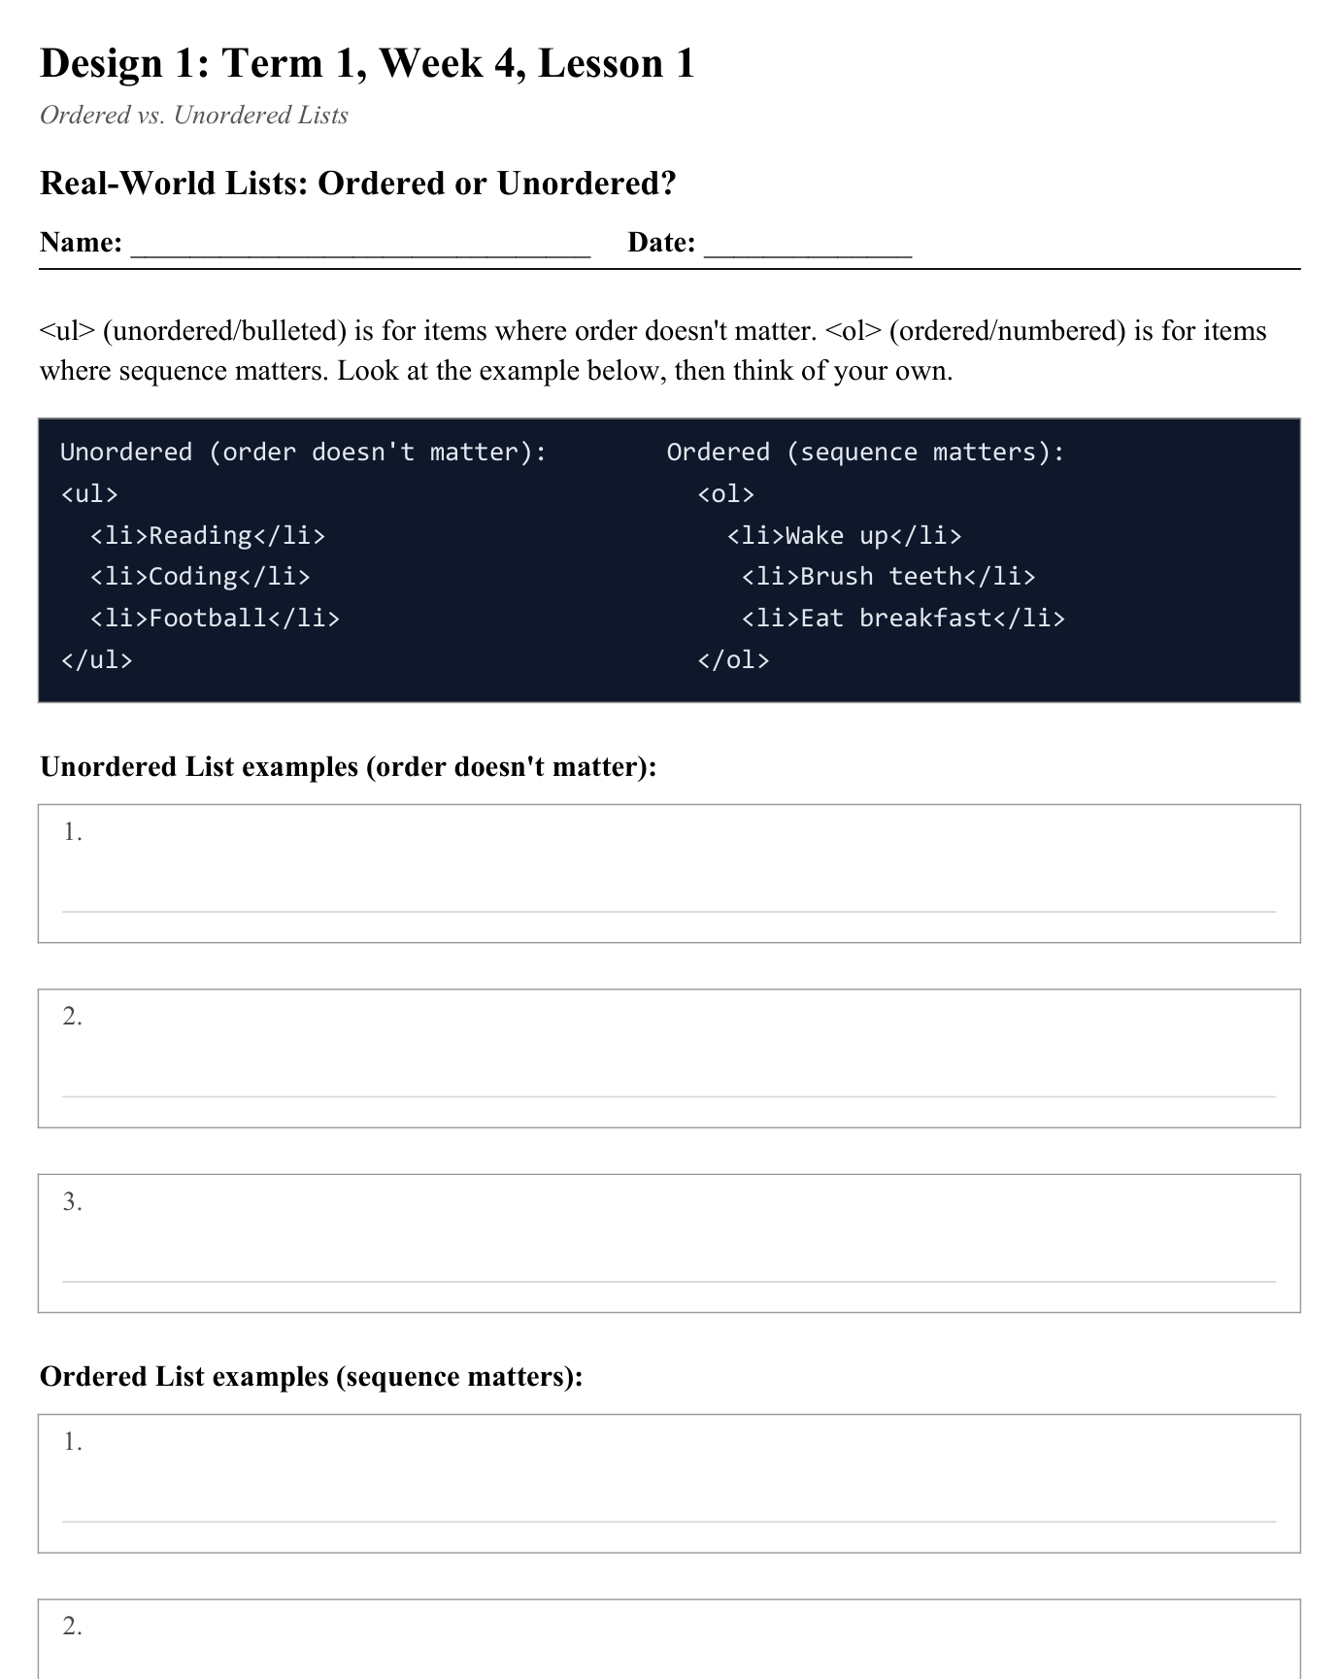
LESSON CORE
You Do: Real-World Lists
Identify 3 real-world examples from your own life for each list type - write them on the worksheet.
Activity: Real-World Lists - Ordered or Unordered?
Gradual Release of Responsibility
30 - 40 minutes
3 / 3

Slide 10
CLOSURE
Exit Ticket
Would a website's main navigation menu be an ordered or unordered list - and why?
Transition & Extend
5 - 10 minutes

